Slide 1




TECH
QUIZ CRAZE
Smart Quiz Platform for Educators & Students
EXPO
Code Ace
BY,
SUDHARSAN A
Santhosh G
Arsath Noordeen A

Slide 2
INTRODUCTION
Quiz Craze is a smart quiz platform built with React and Firebase. It empowers educators to create engaging tests and allows students to take them seamlessly. Ideal for classrooms, colleges, or any learning environment looking to assess knowledge effectively.
🌐 Live Link

Slide 3

PROBLEM
Teachers spend too much time manually creating and managing quizzes
Students need quick feedback to improve learning
Traditional tests lack instant result tracking
Managing quiz history and scores is difficult without a system
Need for interactive, secure, and digital assessment tools
Existing platforms are either too complex or limited in functionality

Slide 4




TECH STACK
Frontend: React, TailwindCSS, React Router
Backend / Database: Firebase Auth, Firestore
State Management: Zustand for global state persistence
Form Validation: React Hook Form + Zod
Icons & UI Components: Lucide Icons
Built with modern responsive design principles
React
React State Mangement
Tailwindcss
Firebase

Slide 5
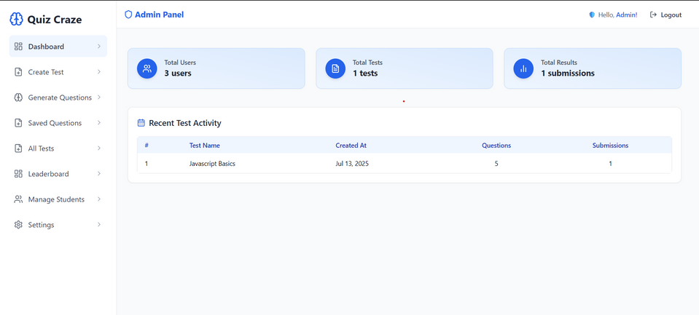
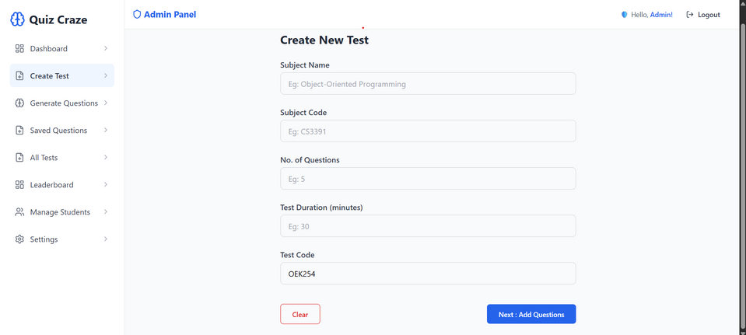
ADMIN FEATURES
Create and edit quizzes with multiple questions
Save quizzes for later use
Monitor total users, quizzes, and activity
View and manage student results
Clear data with one click when needed
Role-based access ensures only admins can manage quizzes

Slide 6
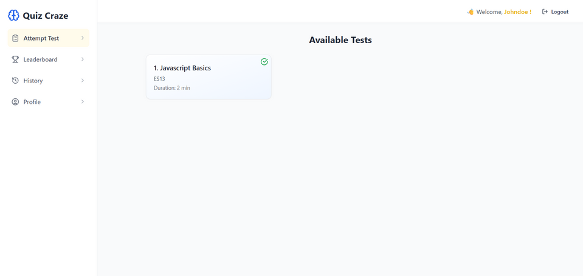
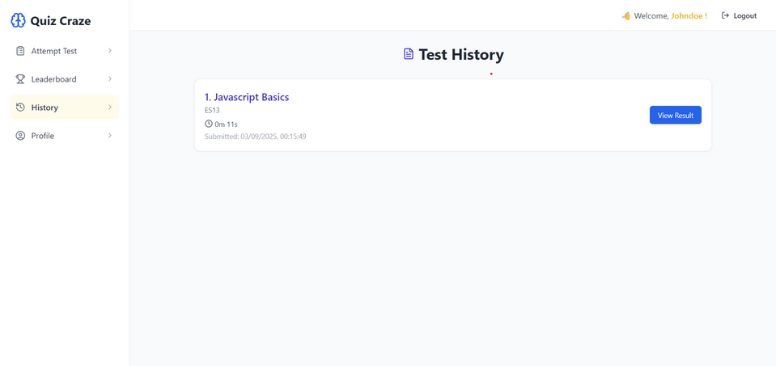
STUDENT FEATURES
Sign up with Register Number, Email & Password
Take timed quizzes with real-time answer saving
Get instant results with correct answers highlighted
Access previous quiz history (recent activity)
Interactive UI makes quizzes fun and engaging
View performance trends over time

Slide 7



📝 QUIZ CREATION & MANAGEMENT
Admin can generate quizzes quickly
Questions support multiple-choice options
Correct answers are highlighted automatically
Quizzes can be saved for future reuse
Students can attempt quizzes anytime
System keeps track of attempts and scores
Admin Create Quiz
Save
Students Attend

Slide 8
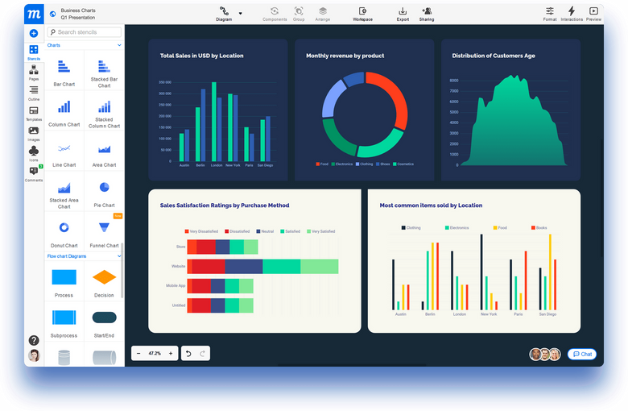
FUTURE ENHANCMENTS
AI-powered quiz suggestions & auto-generation
Analytics dashboard for Admin to track student performance
Support for more question types (e.g., fill-in-the-blank, matching)
Mobile app version for easy quiz access on smartphones
Enhanced security & role-based permissions

Slide 9
LINKS
Live demo: https://quiz-craze-pi.vercel.app
GitHub repository: quiz-app-for-college

Slide 10
THANK
YOU

